Slide 1


CLINICS
APPOINTMENT
MANAGEMENT
SYSTEM
GROUP 13

Slide 2
CHAPTER 1:
Introduction
Rationale
Objectives of Study
Scope and Limitations
Clinics Appointment Management System

Slide 3
rationale
Healthcare for the society is necessary as it can lead to longer, healthier and happy lives.
Having a regular check-up with a doctor can help us stay on top of our health.
Sad to say that most of us refuse to visit a doctor and only do self-medication or simply enduring the sickness according to Gary de Ocampo, CEO of Kantar Philippines.
Factors in choosing a doctor includes the expertise, time management, rate, convenience and the relationship with their patient.
Clinics Appointment Management System

Slide 4
rationale
And having a consultation with a doctor gets a lot of complaints like:
  Long queues
  Canceled and rescheduled appointments
  The traditional style of queueing made it a lot worse as it lacks convenience and time management
  Waits for hours without getting notified if it was canceled or not
  Does not know the doctor to approach or in what specialization
Clinics Appointment Management System

Slide 5
rationale
To address these issues, the researchers came up with a study that will significantly improve the healthcare services of the clinic in terms of convenience and efficiency in accommodating the patients through their flexible and comfortable time where reservation of appointment can be done anytime and anywhere.
Clinics Appointment Management System

Slide 6
Clinics Appointment Management System
is a web-based application that provides a facility for doctors and patients to arrange or schedule clinic appointments conveniently and with appropriate notifications.
caters different clinics that are registered in the system and will enable the patients to search a doctor based on his preferences.
It will cater different clinics of Holy Name University Medical Center Foundation Inc.
Clinics Appointment Management System

Slide 7
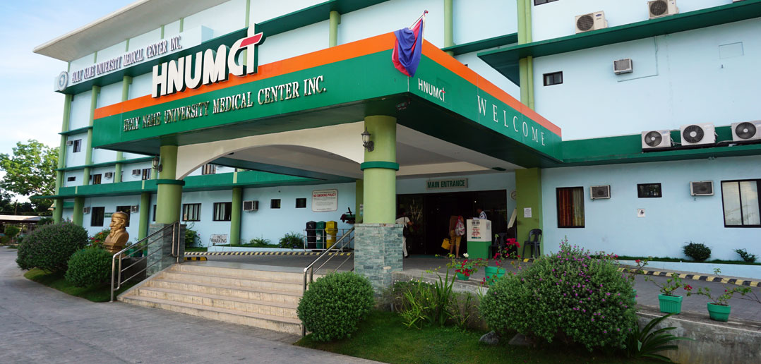
HOLY NAME UNIVERSITY MEDICAL Center foundation, INC.
is located inside the premises of HNU's Dampas Campus, Tagbilaran City Bohol.
Currently run by CEO Fr. Michael Tangente, SVD and the Medical Director, Dr. Angelito Lechago, MD.
Initially opened as a 50-bed, level II hospital with a tertiary level laboratory, but it is geared towards becoming a level III.
Has 18 clinics and 56 doctors
Clinics Appointment Management System

Slide 8
HOLY NAME UNIVERSITY MEDICAL Center foundation, INC.
Areas of specialization include
Anesthesiology,
Pediatric,
EENT,
Family
Medicine,
Obstetrics-Gynecology,
Rehab Medicine, and
Surgery which includes
  Orthopedics
  Neurosurgery
Internal Medicine which includes Rheumatology, Nephrology, Gastroenterology, Cardiology, Endocrinology, Diabetology, and Neurology
Clinics Appointment Management System

Slide 9
Objectives of the Study
Specifically the study aims to:
1. To have a thorough understanding of the different processes and practices in managing doctor’s appointments in a hospital clinic;
2. To identify current processes that need improvements;
Clinics Appointment Management System

Slide 10
Objectives of the Study
3. To provide a comprehensive solutions to the current problems of the existing systems; and
4. To have systematic reports on clinic appointments.
Clinics Appointment Management System

Slide 11
Scope and Limitations of the Study
Focuses on the study of all clinics in HNU Medical Hospital, Dampas Dist. Tagbilaran City
focuses mainly on managing user and patient accounts, and appointments
Generate reports on a beginning and ending date
SMS notification is used for queuing and cancelling of appointments notification.
The study does not include the pre-consultation and the diagnosis of the actual consultation made
Clinics Appointment Management System

Slide 12
CHAPTER 2:
TECHNICAL BACKGROUND
Clinics Appointment Management System

Slide 13
Technical Background
The Clinics Appointment Management System is a transaction processing system (TPS) which enables patients, doctors’ secretaries, and doctors themselves to manage clinic appointments.
It aims to provide a platform for patients, HR department as admin, secretaries and doctors of multiple clinics of the Holy Name University Medical Center Foundation Inc.
Clinics Appointment Management System

Slide 14
Technical Background
The system also manages:
(a) patients records, e.g., basic personal and contact information and medical complaints for appointment with the doctor,
(b) appointment schedules,
(c) notification of doctors/patients on the current queue through the application, and
(d) generate reports on completed appointments.
Clinics Appointment Management System

Slide 15

AGILE METHOD
The agile method anticipates change and allows for much more flexibility than traditional methods.
The process involves breaking down each project into prioritized requirements, and delivering each individually within an iterative cycle.
Each iteration is reviewed and assessed by the development team and client.
We adapt this method as we are going to work hand-in-hand with the clients, which are the hospital HR department as the admin, as well as the doctors, secretaries, and patients with regards to the functionalities of the system until the all modules are completed.
Clinics Appointment Management System

Slide 16
CAPABILITIES
The system can manage users, create account types and users.
Manage appointment information, manage and displays appointment history and set limit number of appointments per day.
Serve as a search engine for doctors according to its specialization.
Manage patient, view patient history, and edits patient profile.
Clinics Appointment Management System

Slide 17
Features
Generates queue number
Sends SMS notification in queuing and cancellation of appointments.
3. Generate monthly reports on statistical data about the average appointments per day and completed appointments per day
Clinics Appointment Management System

Slide 18
CHAPTER 3:
Methodology
Clinics Appointment Management System

Slide 19
Analysis
The system analysis is done through the use case diagram and use case narrative.
The use case diagram show the structure composing relationship between the system and the user.
The system has four users, the patient, doctor, secretary and the admin. All the users must login to their accounts.
Only the secretary and doctor can view patient records/history for confidentiality.
Clinics Appointment Management System

Slide 20
USE CASE DIAGRAM
Clinics Appointment Management System

Slide 21
RELATIONAL DATABASE
Clinics Appointment Management System

Slide 22
PROGRAM HEIRARCHY
Clinics Appointment Management System

Slide 23
Development
It uses Codeigniter framework which follows the model-view-controller (MVC) architectural pattern for easy manipulation of databases, a plus for its mobility and for well-documentation.
It uses MySQL since it is a free, open-source database management system. It is very stable and has a big community that helps maintain and debug it.
Clinics Appointment Management System

Slide 24
Testing
In the development, testing is essential as it serves as a guide to point out errors that were made.
The researchers conduct a study by interviewing five clinics and five patients asking how scheduling an appointment is done before, during, and after the consultation.
The researchers will assess and evaluate the results and use them to improve the system efficiently and effectively for the users.
Clinics Appointment Management System

Slide 25
CHAPTER 4:
RECOMMENDATIONS
Clinics Appointment Management System

Slide 26
Recommendations
For further enhance the system, the following are recommended:
1. Add a pre-consultation and consultation modules for the patients.
2. Add a payments module that handles payments for consultations which includes the issuance of a payment slip (unofficial receipt).
3. Add a ledger on appointments or an appointments history for physicians and secretary and patients.
Clinics Appointment Management System

Slide 27
CHAPTER 5:
IMPLEMENTATION PLAN
Clinics Appointment Management System

Slide 28
deployment plan
The system can be accessed using a tablet, laptop of desktop computer with a relatively recent browser version such as Google Chrome and Mozilla Firefox.
For computer desktops, the recommended minimum specifications is a Windows 7-based operating system up to the latest version with at least 2GB RAM and a dual-core processor running at a clock speed of 2.5 Ghz. The specifications are applicable to the patients, doctors, and secretaries desktop computers.
Clinics Appointment Management System

Slide 29
conversion plan
Parallel conversion will be applied in which the manual system will run in parallel or simultaneously with the proposed online appointment management system. This approach decreases the risk of interruptions in the business operations in case of a failure and still allow the users to test the different capabilities and familiarize the new system.
Clinics Appointment Management System

Slide 30
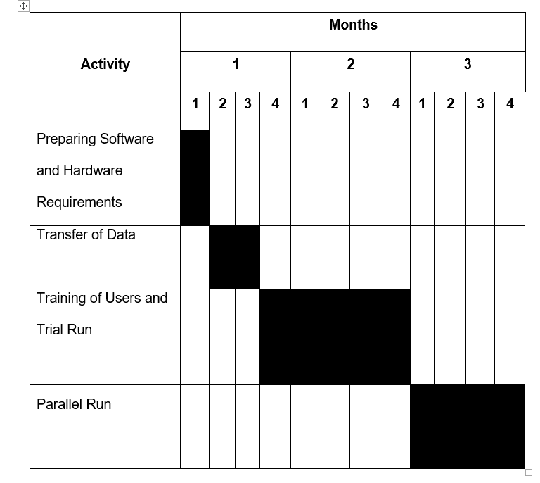
conversion plan
Clinics Appointment Management System

Slide 31
Preparing of software and hardware requirements
includes the acquiring web hosting service and installation of the system into the web host including the initial functionality tests of the application. This activity will take about a week.
Clinics Appointment Management System

Slide 32
Transfer of data
includes the conduct of trainings to the authorized users of the system as to how the system would work in accordance to the company processes. This would take two weeks.
Clinics Appointment Management System

Slide 33
Parallel Run
includes the running of the online clinic appointment management system in parallel with their manual business processes. If there are any errors found out the researchers will examine and prepare for an action directly. This would take a month.
Clinics Appointment Management System

Slide 34
Policies of the System
Appointments shall be booked at least one (1) day before the desired date of the appointment.
Cancelation of appointments shall be done at least one (1) day before the appointment.
Canceled appointments will not be deleted but instead will be given a status of ‘Canceled’ to keep its record.
The Human Resource Department is the only user who can register new physician and secretary.
The physician/secretary needs to request personally to the admin for the registration of his/her clinic.
Clinics Appointment Management System

